Slide 1
Pharma Analysis
KAYALVIZHI S

Slide 2
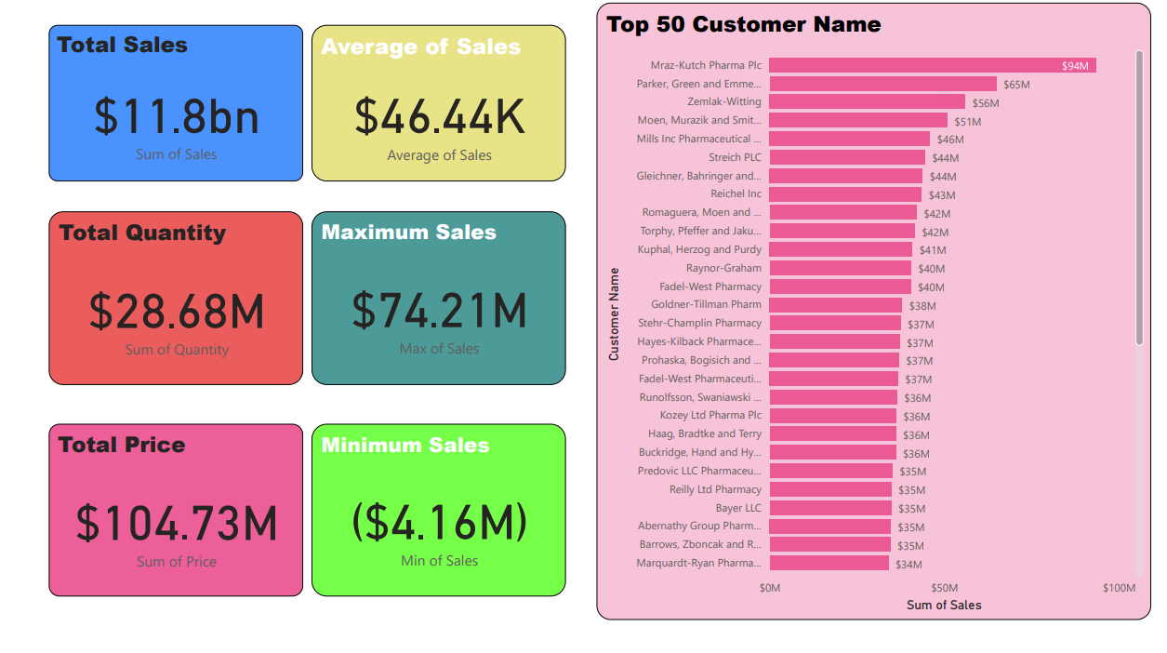

Slide 3
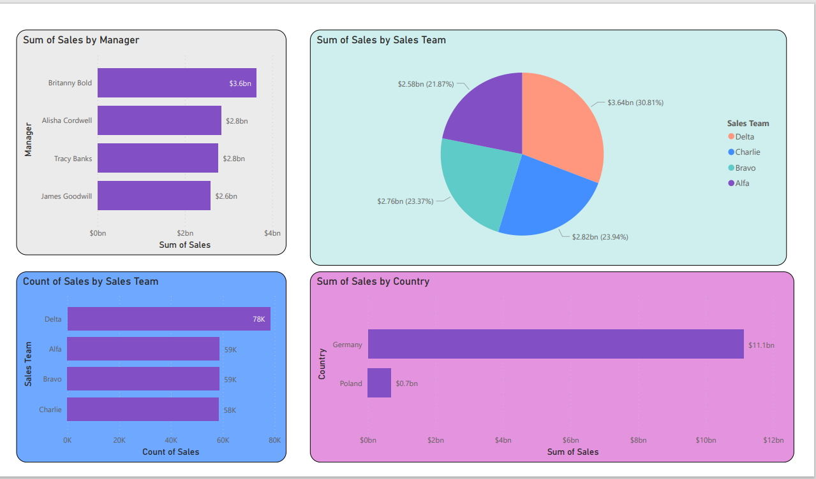

Slide 4
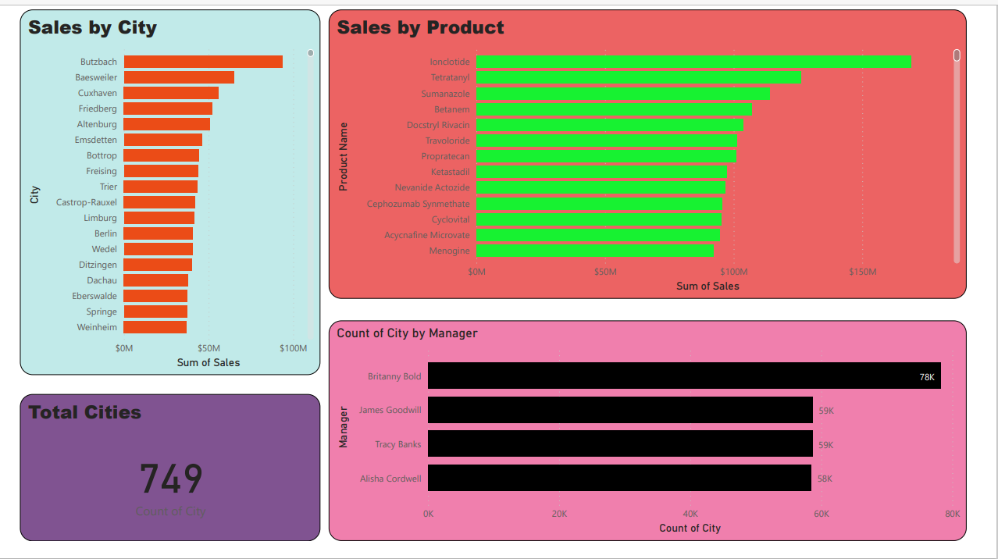

Slide 5
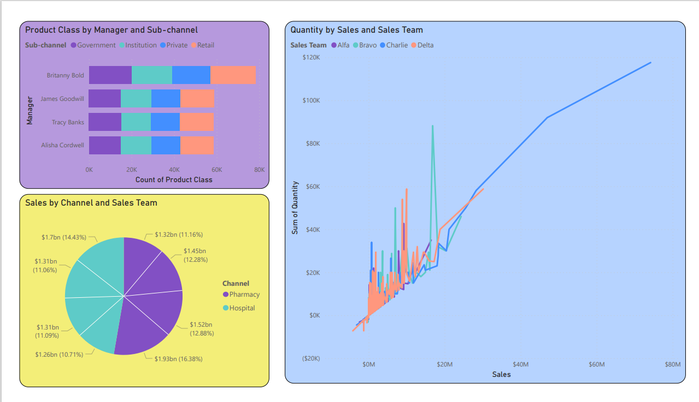

Slide 6
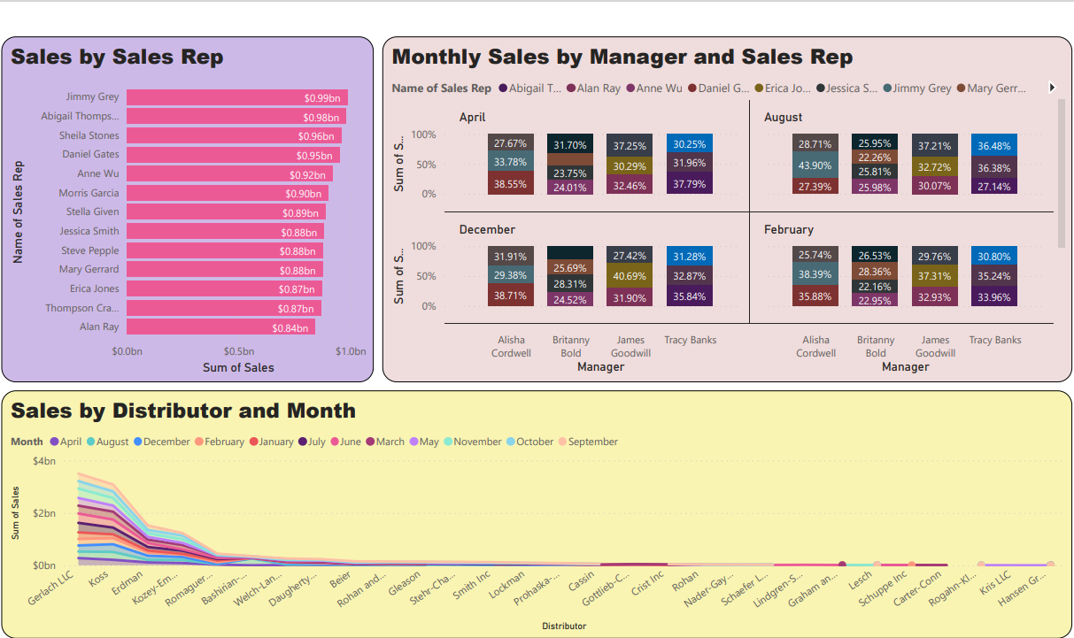

Slide 7
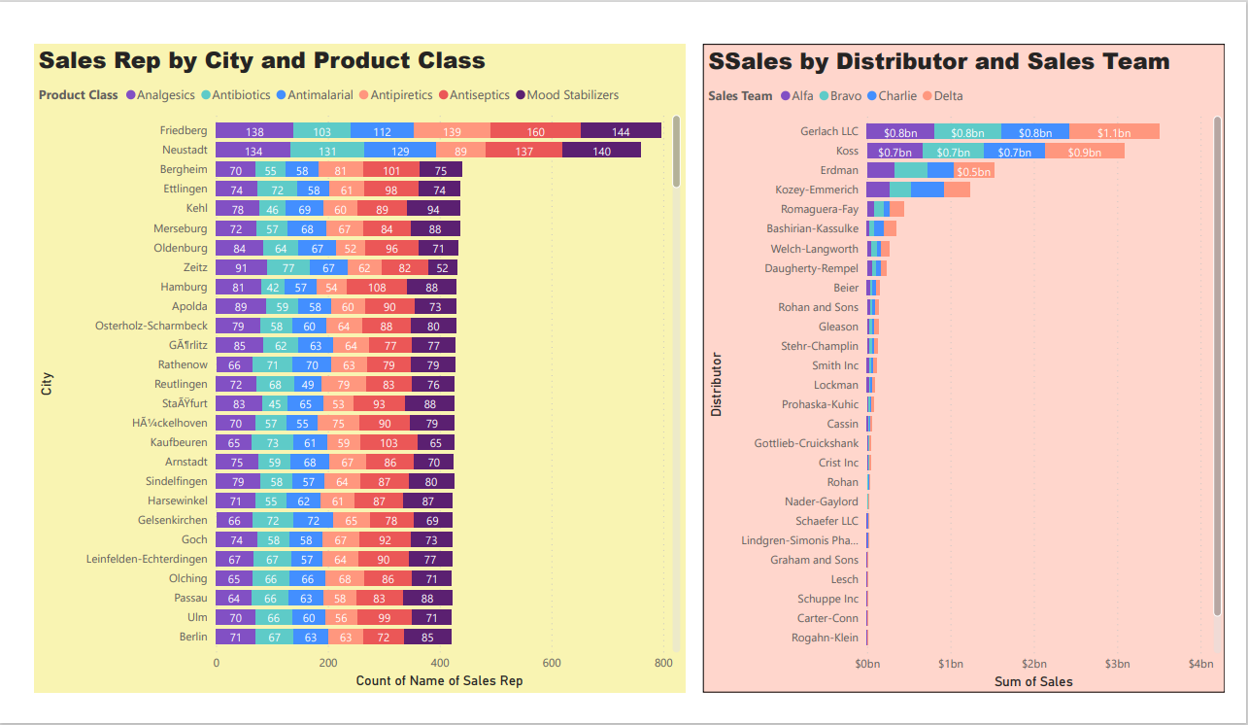

Slide 8
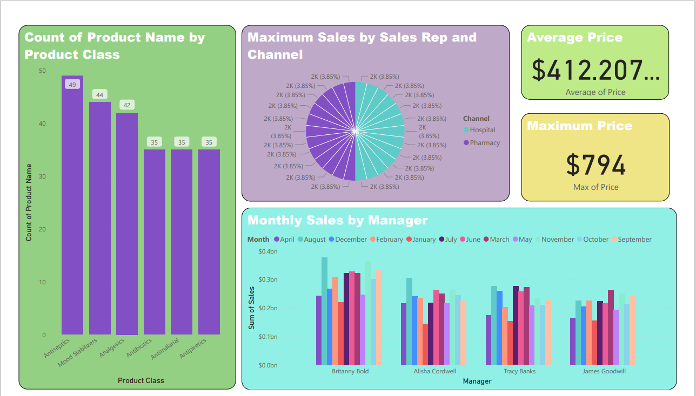

Slide 9
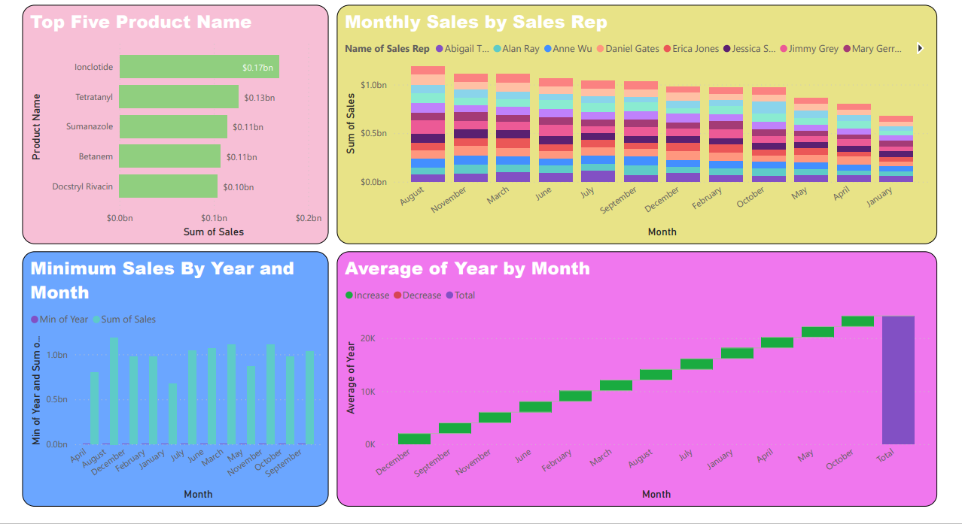

Slide 10
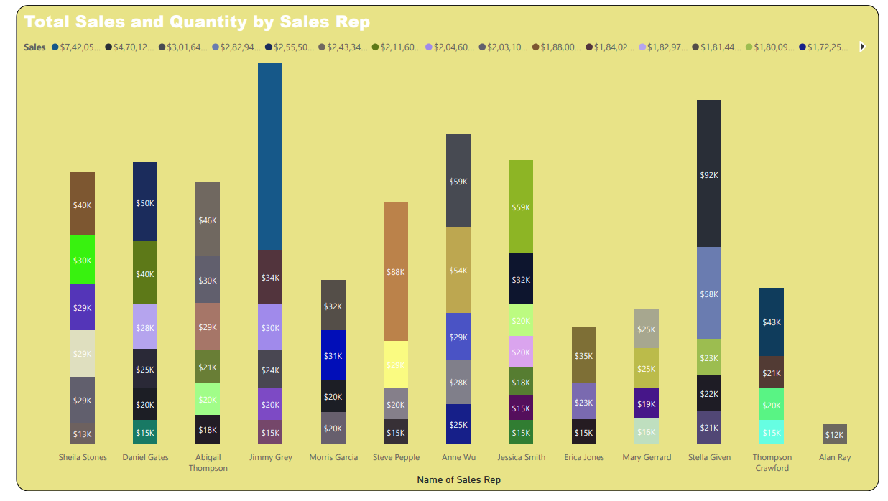

Slide 11
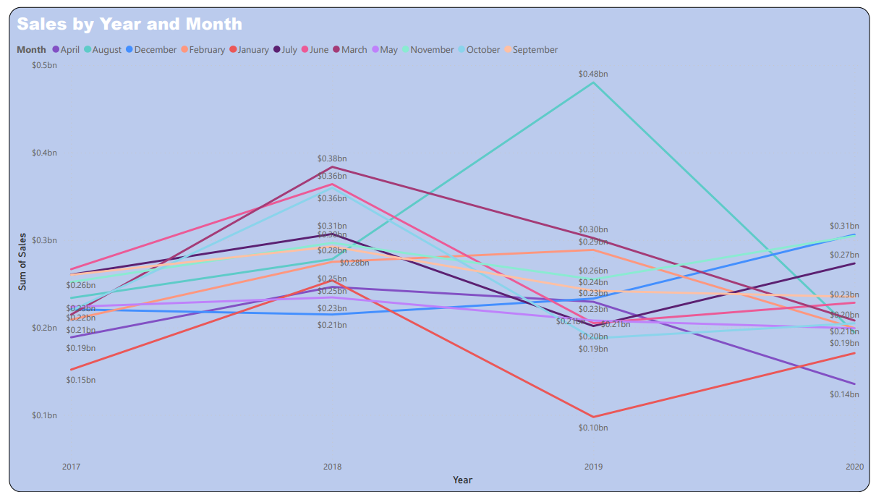

Slide 12
📊 Power BI Analysis Highlights: Pharma Sector
🚀 Total Sales: $11.8bn
🌐 Total Quantity: $28.68M
💹 Total Price: $104.73M
🌟 Top Insights:
Top 5 Products: Ionclotide, Tetratanyl, Sumanazole, Betanem, Docstryl Rivacin
Top Sales Rep: Abigail Thompson with $0.99bn
🌍 Geographical Breakdown:
Top Country: Germany - $11.1bn
Total Cities: 749
Sales by City: Butzbach, Baesweiler, Cuxhaven, and more
👩‍💼 Sales Team Performance:
Top Manager: Britanny Bold - $3.6bn
Sales Team Contribution: Delta - $3.64bn (30.81%)
📈 Monthly Trends:
Best Month: August
Monthly Sales Growth: 43.90% managed by Alisha Cordwell

Slide 13
🔍 Detailed Analysis:
Product Classes: Antiseptics, Mood Stabilizers, Analgesics, Antibiotics, and more
Sales Channels: Pharmacy, Hospital
Distributor Impact: Gerlach LLC, Koss, Erdman, and others
📅 Yearly Overview:
2017 - 2020 Sales: Varied trends, peaking at $0.48bn in 2019
🌐 Conclusion:
Empowering Pharma insights through comprehensive Power BI analysis. Leveraging data for strategic decisions and growth. Exciting developments in product performance and regional impact.

